Slide 1
I am what I eat
Тюпин Георгий
6-Н
ГБОУ шлола № 1571
Исследовательская работа “I am what I eat”

Slide 2
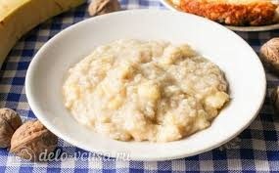
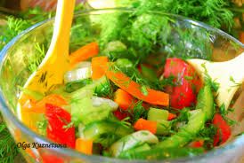

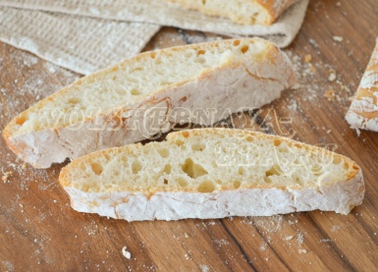
breakfast
Monday
drink
lunch
dinner
snack
Porridge with bananas
Black Tea
salad with bell pepper and cucumber
roast potatoes
Black Tea
water
Paprika chips
Ciabatta
Crackers TUC

Slide 3
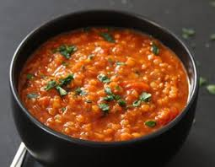
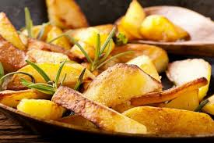

breakfast
Tuesday
drink
lunch
dinner
snack
Porridge with bananas
water
Red lentils
soup
roast potatoes
yogurt
Black Tea
water
Straw
Crackers TUC

Slide 4
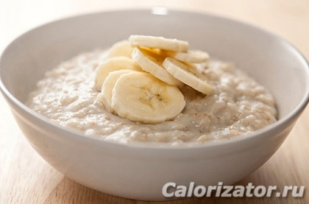
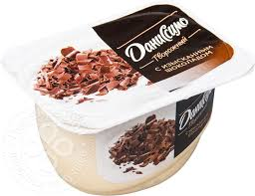

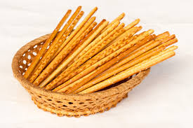
breakfast
Wednesday
drink
lunch
dinner
snack
Baked
straw
Crackers TUC
Marmala-de
Porridge
Black Tea
yogurt
Black Tea
water
Red lentils
soup

Slide 5
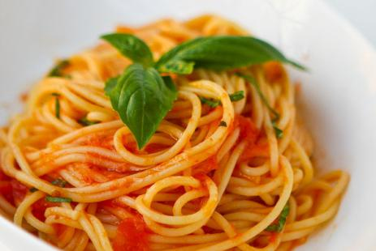
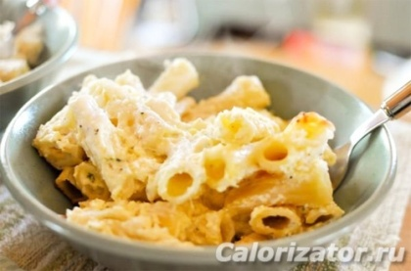
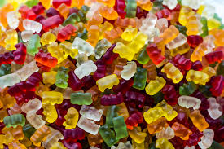
breakfast
Thursday
drink
lunch
dinner
snack
Porridge
Pasta with tomato sauce
Fried рasta and cheese
yogurt
Black Tea
water
Marmala-de

Slide 6
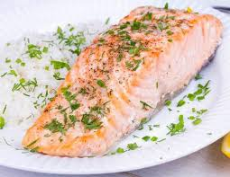
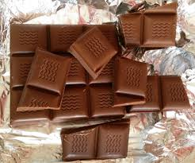
breakfast
Friday
drink
lunch
dinner
snack
Porridge with bananas
Black tea
Rice and salmon
chocolade
Red lentils soup
Black Tea
water

Slide 7
breakfast
Saturday
drink
lunch
dinner
snack
Porridge
Black Tea
Pasta with tomato sauce
Black Tea
water
chocolade

Slide 8
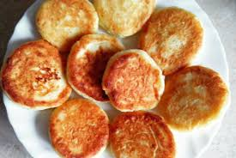
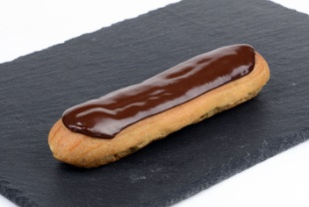
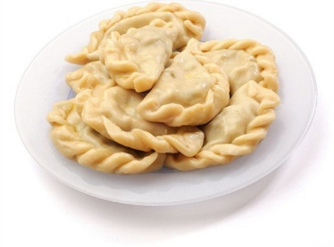
breakfast
Sunday
drink
lunch
dinner
snack
Black Tea
water
Chocolade eclaire
Cottage cheese pancakes
Porridge with bananas
Black tea
ricotta dumplings with olive oil
Fried рasta and cheese

Slide 9
Thanks for your attention

